Slide 1
Database - Database Access -

Slide 2
Contents
How is Database Access performed?
Where to store the accessed Records – INTO clause
Get information from multiple sources – JOIN clause
Time to Practice

Slide 3
How is Database Access performed?

Slide 4
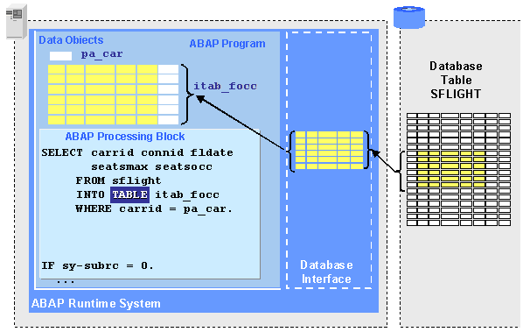

Database Access – SELECT statement
When you want to extract specific data from one or more sources, you can use a select query. A select query helps you retrieve only the data that you want (not the entire information stored in Database), and also helps you combine data from several data sources.
SELECT statement is used to read/access data from DATABASE tables.
Internal Table
(at program level)

Slide 5
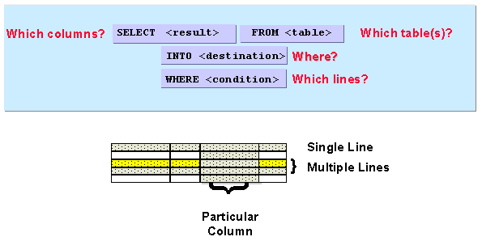
SELECT statement
SELECT, FROM and INTO are mandatory elements of a Select statement in ABAP. WHERE conditions are optional, but they are used in most cases as only partial information is retrieved at program level.
SELECT * means that all columns from a DB table will be selected.

Slide 6
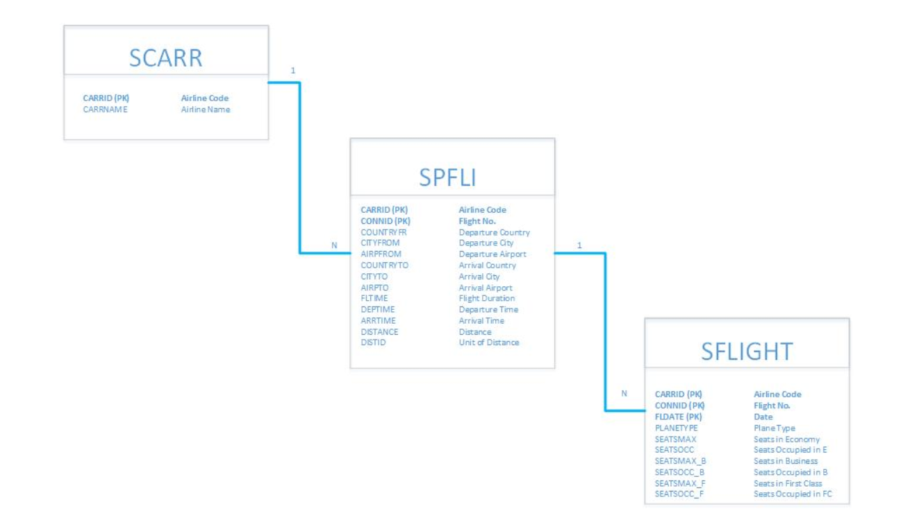
Database schema
We are going to work with the following DATABASE TABLES.
Primary Key
Airline
SCARR table keeps the Airline companies and their characteristics.
Primary Key
Flight
SFLIGHT table keeps the all the flights operated by the Airlines.
Flight Schedule
SPFLI table keeps the all routes operated by the Airlines.
Primary Key

Slide 7
INTO clause

Slide 8
Where to store the selected records?
Based on the selected information several DATA objects can be used to store the information:
Variables – select single record from a single column (very rare)
Structures – select single record from one or multiple columns
Internal tables – select multiple records from one or multiple columns
OBS: In this example, the Structure object has the same structure as the Database Table (same fields), while the Internal Table has a different structure (different number of fields).
DATABASE Table
NAME (C20) | CNP (N13) | ADDRS (C25) | AGE (I)
Resident 1 | 1234567890123 | ABC | 24
Resident 2 |  | DEF25 | 30
Resident 3 | 1111111111111 |  | 12
Resident 4 | 2222222222222 |  | 45
Variable
Internal Table
Structure

Slide 9
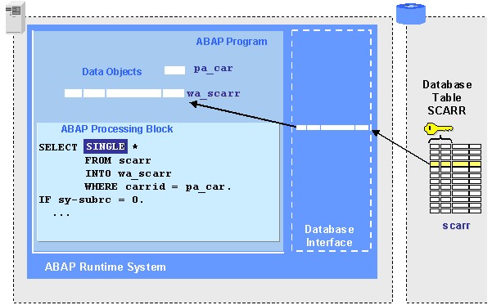


Processing Single Records – SELECT into Structure
v_carrid
v_carrid.

Slide 10
Processing Single Records – SELECT into Structure
Requirement: Display the Airline Name for Carrier ‘LH’.
DATA: s_scarr TYPE scarr.
SELECT SINGLE *
FROM scar
INTO s_scarr
WHERE carrid = ‘LH’.
IF sy-subrc = 0.
WRITE : s_scarr-carrid, s_scarr-carrname.
ENDIF.
OBS: DB Table structures can be used as Global Types.
S_SCARR structure will have the same fields as DB Table SCARR.
OBS: SY-SUBRC = 0 means that
SELECT was operated with success and at least one record was selected.

Slide 11
Processing Single Information – SELECT into Variable
DATA: v_carrid TYPE scarr-carrid,
v_carrname TYPE scarr-carrname.
SELECT SINGLE carrid carrname
INTO (v_carrid, v_carrname)
FROM scarr
WHERE carrid = ‘LH’.
WRITE : v_carrid, v_carrname.
OBS: The order of FROM and INTO clauses may vary.

Slide 12


Processing Multiple Records – SELECT into ITab
v_carrid.

Slide 13
Processing Multiple Records – SELECT into ITab
Requirement: Display the Price of all flights operated by LH on 17.03.2018.
DATA: t_sflight TYPE TABLE OF sflight,
s_sflight TYPE sflight,
v_carrid TYPE sflight-carrid VALUE ‘LH’.
SELECT *
FROM sflight
INTO TABLE t_sflight
WHERE carrid = v_carrid AND
fldate = ‘20180317’.
LOOP AT t_sflight INTO s_sflight.
WRITE : / s_sflight-carrid, s_sflight-connid,
s_sflight-price.
ENDLOOP.
OBS: DB Table Fields can be used as Global Types for variable definition.
OBS: Internal Tables can’t be directly displayed.
Only an Elementary Object can be displayed at time.

Slide 14
Processing Multiple Records – SELECT into ITab
Requirement: Select 10 flight schedules for a specific flight connection.
TYPES: BEGIN of ty_flight,
connid TYPE connid,
carrname TYPE carrname,
END OF ty_flight.
DATA: t_flight TYPE TABLE OF ty_flight.
SELECT carrid connid UP TO 10 ROWS FROM spfli INTO TABLE gt_spfli WHERE connid = p_connid.

Slide 15
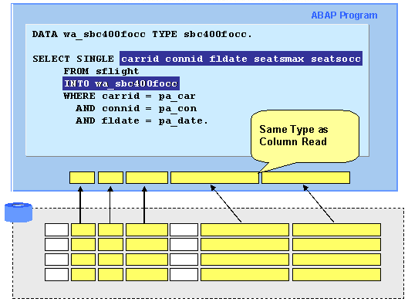
DATA object with same structure type
Structure or Internal table has the same structure (the same field types and the same order to fields) as the Selected information.

Slide 16
DATA object with same structure type
TYPES: BEGIN OF ty_scarr,
carrid TYPE scarr-carrid,
carrname TYPE scarr-carrname,
url TYPE c LENGTH 50,
END OF ty_scarr.
DATA: s_scarr TYPE ty_scarr,
t_scarr TYPE TABLE OF ty_scarr.
SELECT SINGLE carrid carrname url
FROM scarr
INTO s_scarr
WHERE carrid = ‘LH’.
SELECT carrid carrname url
FROM scarr
INTO TABLE t_scarr.

Slide 17
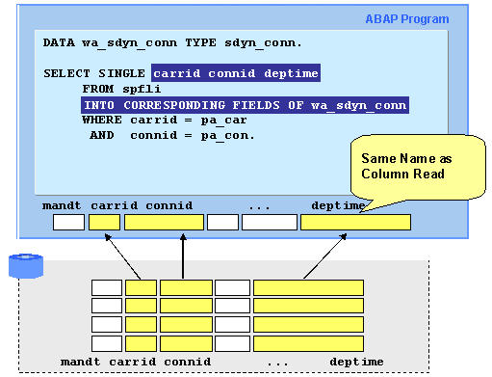
DATA object with same structure field name
Structure or Internal table has different structure (different field types or different order of fields) as the Selected information.

Slide 18
DATA object with same structure field name
OBS: For CORRESPONDING FIELDS OF pay attention to the field names!!!
If the field names from the Structure or Internal Table are different from the field names from DB tables, the information will not be stores.
DATA: s_scarr TYPE scarr,
t_scarr TYPE TABLE OF scarr.
SELECT SINGLE carrid carrname
FROM scarr
INTO CORRESPONDING FIELDS OF s_scarr
WHERE carrid = ‘LH’.
SELECT carrid carrname
FROM scarr
INTO CORRESPONDING FIELDS OF TABLE t_scarr.

Slide 19
JOIN clause

Slide 20
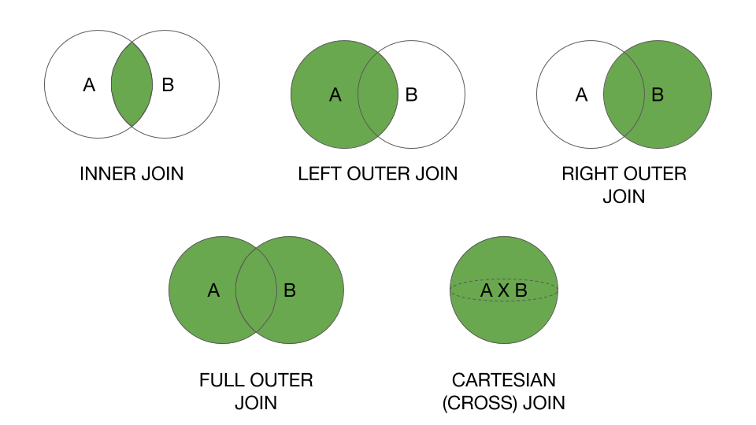
JOIN Types
JOIN clause is used when selection is performed from two or multiple Database Tables which can be linked through a relational condition (the DB tables have at least one common information/field).

Slide 21
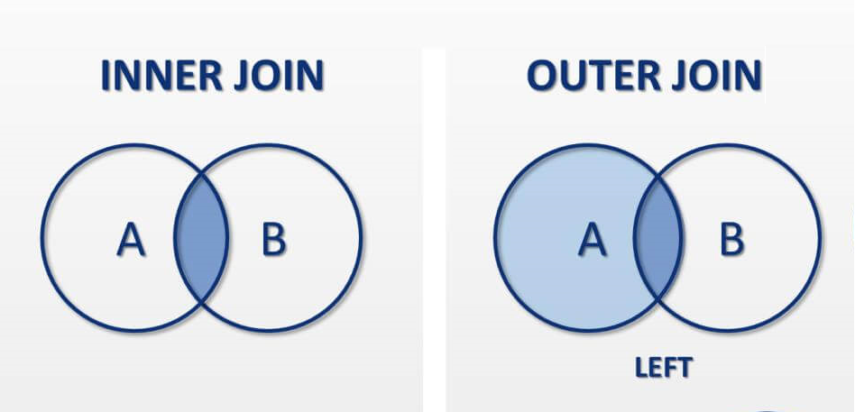
JOIN in ABAP
One thing to keep in mind when using INNER JOIN is that, only the rows that are common on both tables included in JOIN will be selected, so if in second table the JOIN doesn’t find a common row to primary table, than no data is selected even from the primary table.
The OUTER JOIN different from the INNER JOIN, even if in secondary table doesn’t find a row common to primary table, still will get the row from the primary table, so in some cases is more useful to use OUTER JOIN than INNER JOIN.

Slide 22
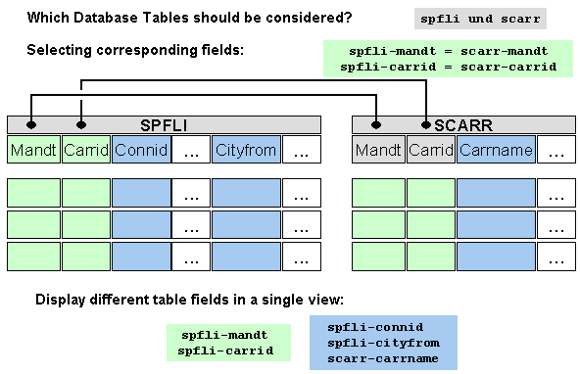
JOIN structure

Slide 23
JOIN structure
SELECT statement | Possible values | Comments
SELECT | * | Select all fields from the Joined Tables
 | TABLE~FIELD .. TABLE~FIELD | If there are fields with Same Name in the Joined Tables, one table needs to be specified
 | FIELD1 FIELD2 … FIELDn | Select specific fields from the Joined Tables
INTO | structure | Select SINGLE line; pay attention to field types and order
 | CORRESPONDING FIELDS OF structure | Select SINGLE line; pay attention to field names
 | TABLE iTab | Pay attention to field types and order
 | CORRESPONDING FIELDS OF TABLE iTab | Pay attention to field names
FROM | TABLE1 JOIN TABLE2 | Inner JOIN is default
 | TABLE1 LEFT JOIN TABLE2 | Left Outer JOIN is performed
ON | TABLE1~FIELD1 = TABLE2~FIELD1 [ AND TABLE1~FIELD2 = TABLE2~FIELD2 AND …] | Join conditions needs to be specified; identify the common fields (same field name is not required). Multiple conditions can be included.
WHERE | FIELD condition AND/OR ….. TABLE~FIELD condition | Optional. If there are fields with Same Name in the Joined Tables, one table needs to be specified

Slide 24
[Inner] Join
Table 1 Table 2 |----|----|----|----| |----|----|----|----|----| | A | B | C | D | | D | E | F | G | H | |----|----|----|----| |----|----|----|----|----| | a1 | b1 | c1 | 1 | | 1 | e1 | f1 | g1 | h1 | | a2 | b2 | c2 | 1 | | 3 | e2 | f2 | g2 | h2 | | a3 | b3 | c3 | 2 | | 4 | e3 | f3 | g3 | h3 | | a4 | b4 | c4 | 3 | |----|----|----|----|----| |----|----|----|----|
Inner Join |----|----|----|----|----|----|----|----| | A | B | C | D | E | F | G | H | |----|----|----|----|----|----|----|----| | a1 | b1 | c1 | 1 | e1 | f1 | g1 | h1 | | a2 | b2 | c2 | 1 | e1 | f1 | g1 | h1 | | a4 | b4 | c4 | 3 | e2 | f2 | g2 | h2 | |----|----|----|----|----|----|----|----|

Slide 25
[Inner] Join example
Requirement: Select all Airline Carriers that operate the route from JFK to FRA.
TYPES: BEGIN of ty_flight,
connid TYPE spfli-connid,
carrname TYPE scarr-carrname,
END OF ty_flight.
DATA: t_flight TYPE TABLE OF ty_flight,
s_flight TYPE ty_str.
SELECT spfli~connid scar~carrname
INTO TABLE t_flight
FROM spfli JOIN scarr <- Joined Tables (default INNER)
ON spfli~carrid = scarr~carrid <- Join Condition (common fields; always
WHERE spfli~airpfrom = ‘JFK’ AND specify table)
spfli~airpto = ‘FRA’.
LOOP AT t_flight INTO s_flight.
WRITE: / ‘Flight : ‘ , s_flight-connid, ‘is operated by: ‘, s_flight-carrname.
ENDLOOP.

Slide 26
Left [Outer] Join
Table 1 Table 2 |----|----|----|----| |----|----|----|----|----| | A | B | C | D | | D | E | F | G | H | |----|----|----|----| |----|----|----|----|----| | a1 | b1 | c1 | 1 | | 1 | e1 | f1 | g1 | h1 | | a2 | b2 | c2 | 1 | | 3 | e2 | f2 | g2 | h2 | | a3 | b3 | c3 | 2 | | 4 | e3 | f3 | g3 | h3 | | a4 | b4 | c4 | 3 | |----|----|----|----|----| |----|----|----|----|
Left Outer Join |----|----|----|----|----|----|----|----|----| | A | B | C | D | D | E | F | G | H | |----|----|----|----|----|----|----|----|----| | a1 | b1 | c1 | 1 | 1 | e1 | f1 | g1 | h1 | | a2 | b2 | c2 | 1 | 1 | e1 | f1 | g1 | h1 | | a3 | b3 | c3 | 2 |NULL|NULL|NULL|NULL|NULL| | a4 | b4 | c4 | 3 | 3 | e2 | f2 | g2 | h2 | |----|----|----|----|----|----|----|----|----|

Slide 27
Left [Outer] Join example
Requirement: Select the flight routes operated by all Airline Carriers.
TYPES: BEGIN of ty_flight,
carrname TYPE scarr-carrname,
connid TYPE spfli-connid,
END OF ty_flight.
DATA: t_flight TYPE TABLE OF ty_flight,
s_flight TYPE ty_str.
SELECT spfli~connid scar~carrname
INTO COORESPONDING FIELDS OF TABLE t_flight
FROM scarr LEFT JOIN spfli <- Joined Tables (order matters!!)
ON scarr~carrid = spfli~carrid. <- Join Condition (common fields; always
specify table)
LOOP AT t_flight INTO s_flight.
WRITE: / ‘Flight : ‘ , s_flight-connid, ‘is operated by: ‘, s_flight-carrname.
ENDLOOP.

Slide 28
For All Entries - optional

Slide 29
SELECT FOR ALL ENTRIES
SELECT <field list>
FROM <database table>
INTO TABLE <itab1>
FOR ALL ENTRIES IN <itab2>
WHERE <field1> = <itab2>-field1 AND/OR
<field2> = <itab2>-field2 [AND/OR
<field3> = <variable>/<value>…… ] .
The WHERE condition is performed for each line of the internal table.
For each line, the system selects the lines from the database table that satisfy the condition.
The result set is the union of the individual selections for each line of the internal table.
Duplicate lines are automatically eliminated from the result set.
If itab is empty, the addition FOR ALL ENTRIES is disregarded, and all entries are read.

Slide 30
SELECT FOR ALL ENTRIES example
TYPES: BEGIN of ty_str,
connid TYPE connid,
carrname TYPE carrname,
END OF ty_str.
DATA: t_spfli TYPE TABLE OF ty_str,
t_scarr TYPE TABLE OF scar.
SELECT carrid connid FROM spfli INTO CORRESPONDING FIELDS OF TABLE t_spfli WHERE connid = ‘106’. IF t_spfli IS NOT INITIAL. SELECT carrid carrname FROM makt INTO CORRESPONDING FIELDS OF TABLE t_spfli
FOR ALL ENTRIES IN t_spfli WHERE carrid = t_spfli-carrid. ENDIF.

Slide 31
Time to Practice

Slide 32
Time to Practice: Exercise
Create a program named ZZuser_C5 (user is your login user; eg:g001).
1. Display carrier ID and carrier name for Airline Carrier ‘LH’.
2. Select the first 5 flights operated on May 2018 and ( table SFLIGHT ) and display them.
3. Display the carrier id, carrier name, connection ID, airport from, airport to for Airline ‘LH’. Tables are SCARR and SPFLI. Display the information only if the connection is found for the given carrier.
4. Select the following information for Airline Carrier ‘UA’:
- carrier ID ( SCARR-CARRID )
- carrier_name (SCARR-CARRNAME)
- connection_id (SFLIGHT-CONNID)
- flight_date (SFLIGHT-FLDATE)
- seats_occ (SFLIGHT-SEATSOCC)
If no flight was found, select at least the carrier name.
5. Display how many flights were operated by UA. If no flight was found, display the carrier name.

Slide 33
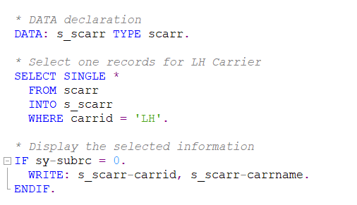
Solution point 1

Slide 34
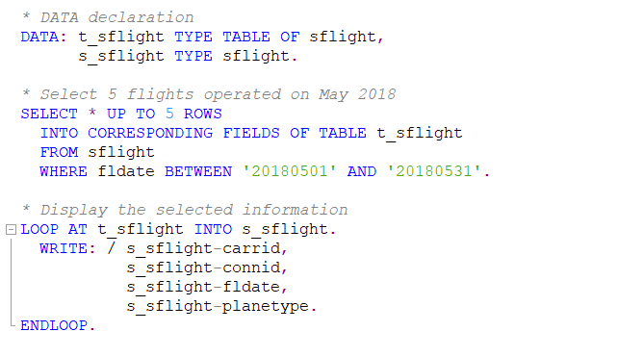
Solution point 2

Slide 35
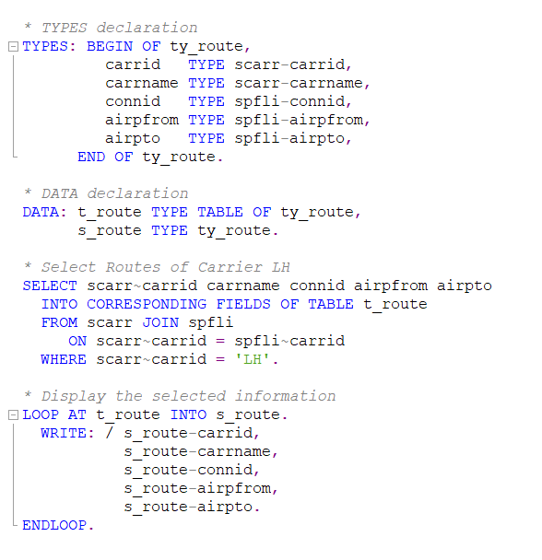
Solution point 3

Slide 36
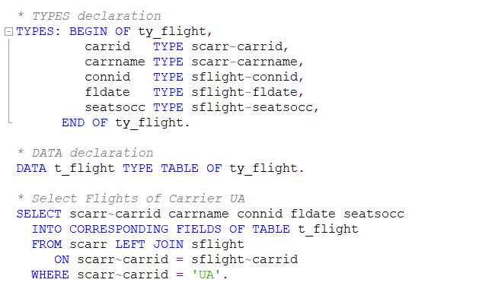
Solution point 4

Slide 37
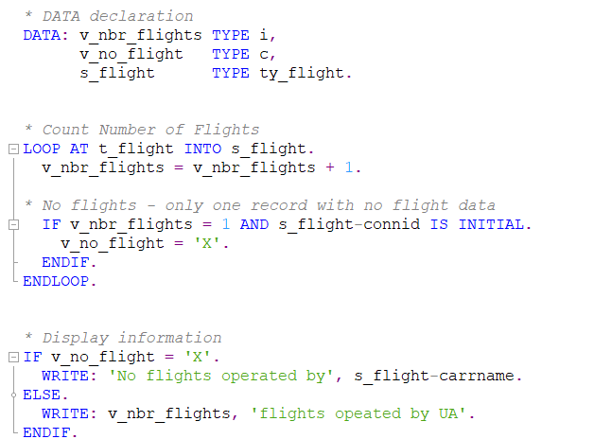
Solution point 5

